Slide 1
Pandas Explore
2025-2026

Slide 2
Pandas explore
Adding 1 row to DataFrame
Combining datasets
Reformat data
Overview in graphs
Boxplots, skewing and distributions

Slide 3
Data exploration
We’ve done data import and data selection in pandas in the previous chapter.
Those were the tools, in this chapter we’re talking about how to use these tools when confronted with a new dataset.
And just a warning: in the course “Data visualisation” you will learn which graphs are appropriate in which case
E.g. You can only use a line graph when plotting continuous variables
We’ll try not to break those rules, but we may stray from the correct path

Slide 4
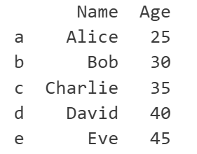
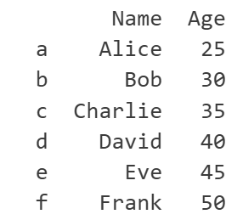
Adding 1 row to DataFrame
Using “.concat”
#Example DataFrame
data = {"Name": ["Alice", "Bob", "Charlie", "David", "Eve"],
"Age": [25, 30, 35, 40, 45]}
df = pd.DataFrame(data, index=['a', 'b', 'c', 'd', 'e'])
print(df)
# new row to add
new_row = {"Name": "Frank", "Age": 50}
# adding the new row
df = pd.concat([df, pd.DataFrame([new_row], index=['f'])])
print("\nDataFrame after adding new row:")
print(df)

Slide 5
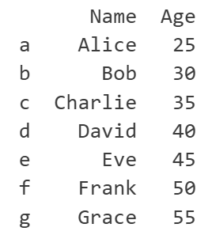
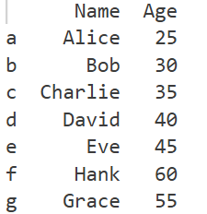
Adding 1 row to DataFrame
Using .loc
new label → new entry
existing label → overwrite entry
#alternative method using loc
df.loc['g'] = {"Name": "Grace", "Age": 55}
print("\nDataFrame after adding new row using loc:")
print(df)
# alternative method using loc with existing index
df.loc['f'] = {"Name": "Hank", "Age": 60}
print("\nDataFrame after adding new row using existing index loc:")
print(df)

Slide 6
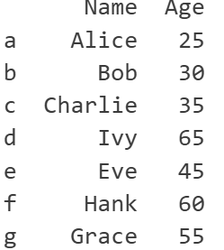
Adding 1 row to DataFrame
Using iloc throws error → only works with existing rows
#adding a new row using iloc will raise an IndexError
df.iloc[7] = {"Name": "Ivy", "Age": 65}
#using an existing index will overwrite the row
df.iloc[3] = {"Name": "Ivy", "Age": 65}

Slide 7


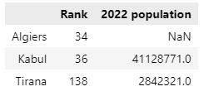
Combining multiple datasets
Real-world data often comes in multiple pieces. You need to know how to grab those pieces and combine them into one dataset and make it ready for analysis.
What the pieces are (pandas Series or DataFrames) may differ
We start with 2 Series: to create 1 DataFrame:
city_rank
city_2022_population
city_data
Notes:
Note: with two series we’re not using any special function, we’re just creating a DataFrame based on the two series.

Slide 8

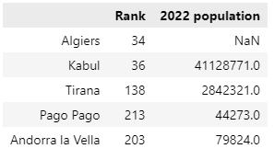
Combining multiple datasets
Next up is combining 2 DataFrames with identical columns
In this example we concatenate 2 DataFrames into a new one
city_data
further_city_data
all_city_data
Notes:
https://pandas.pydata.org/pandas-docs/stable/user_guide/merging.html

Slide 9
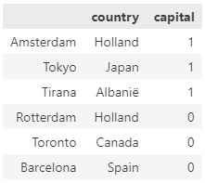
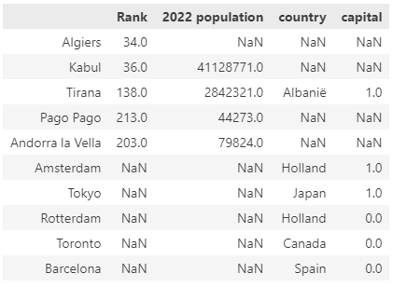
Combining multiple datasets
What happens when they share a key, but have different columns?
city_countries
cities
all_city_data
All rows are kept. NaN appears when no data available
Notes:
Outer join
All values on rows that are not present in the other DataFrame are filled with NA.
Only the Tirana record is complete!

Slide 10
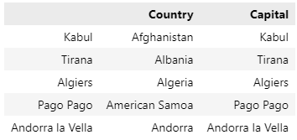
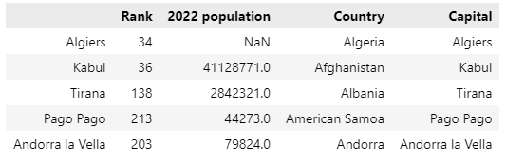
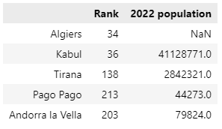
Combining multiple datasets
We can prevent the Na’s by using datasets with combinable data (~key)
capital_countries
capitals
all_city_data
Notes:
“Datasets” -> so DataFrames that have different pieces of information on the same key. Example here: both DataFrames have information on the same Countries.
What we did before (DataFrames with completely different keys) is a bad practice.

Slide 11
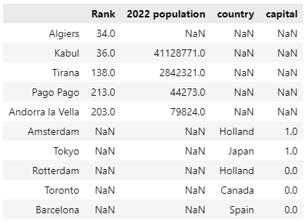
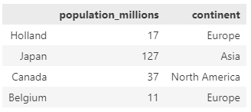
Merge
Merging means that you combine two datasets that don’t share a key column
You choose a column in one DataFrame to link with the key of the other DataFrame
cities
countries

Slide 12
Merge syntax
In the example:
DataFrame countries contains the index
DataFrame cities contains a column ‘country’
Begin by selecting both DataFrames. The order is important!
With “left_index” or “right_index” you decide which of the 2 DataFrames contains the index
pd.merge (countries, cities) → left_index = True
pd.merge (cities, countries) → right_index = True
With “left_on” or “right_on” you decide with which column in the other DataFrame (right of left) the index column must merge
pd.merge (countries, cities, left_index = True) → right_on = country’
pd.merge (cities, countries, right_index = True) → left_on = ‘country’

Slide 13
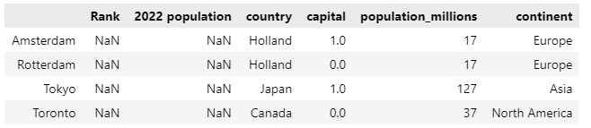
Merge example
countries
cities
Notice how “Belgium” is not retained as it doesn’t have a corresponding row in cities
Same for Algiers, Kabul, … they don’t exist in countries

Slide 14
Merge as inner join
Do watch out: we merged two DataFrames with 4 and 10 rows, and got a 4 row DataFrame as result!
This is because we inner joined. You’ll lose rows that don’t have a match in the other DataFrame’s key column.
Also note: all columns were kept, even those that now only contain NaN-values.

Slide 15
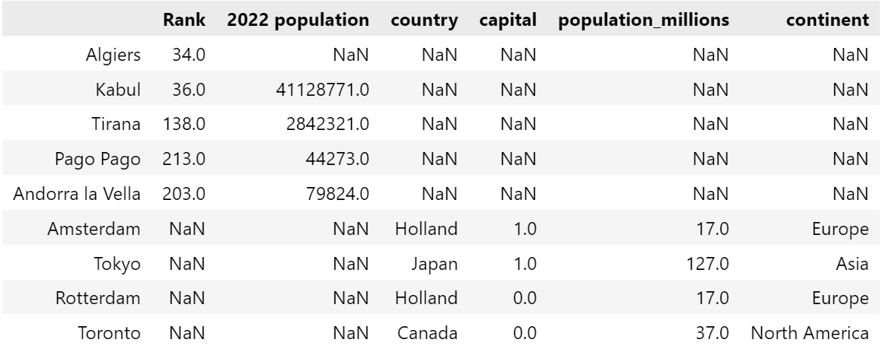
Merge left and right
By default, merge() always performs an inner join.
However, by using the attribute ‘how’ you can indicate the type of join you want to perform
Notes:
‘Barcelona’ is gone because ‘Spain’ isn’t part of the countries DataFrame
The full list:
pd.merge(cities, countries, how="left", left_on="country", right_index=True)
pd.merge(cities, countries, how="right", left_on="country", right_index=True)
pd.merge(cities, countries, how="outer", left_on="country", right_index=True)
pd.merge(cities, countries, how="inner", left_on="country", right_index=True)
pd.merge(cities, countries, how="cross")

Slide 16
Reformat data
Data isn’t always nice and rectangular
Or it is, but it’s the wrong type of rectangle
Or in two rectangles (aka files) that need to be combined
You can reformat your data into the form you need
Another example of reshaping is a pivot table
Pivoting allows you to summarize your data based on certain properties
Helps a lot to get a quick overview of what is going on

Slide 17
DataFrame reshaping
melt():
make wide data long
pivot():
make long data wide
pivot_table():
same as .pivot() but can handle multiple indexes
crosstab()
https://www.tomasbeuzen.com/python-programming-for-data-science/chapters/chapter8-wrangling-basics.html

Slide 18
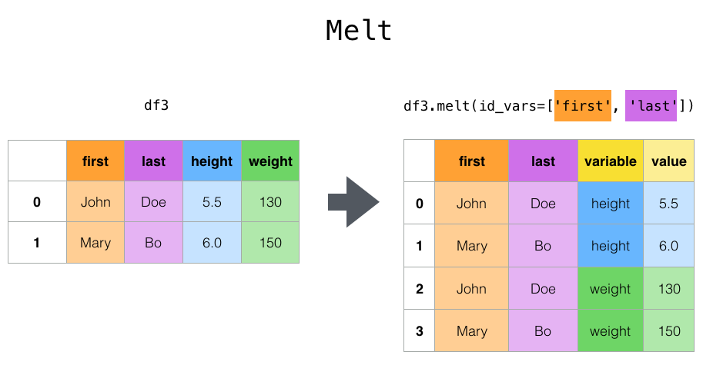
Melt
Used to collapse a DataFrame so that every column becomes a new row
There are some id_vars, they will be copied
The names of the columns are kept as values
https://pandas.pydata.org/docs/_images/reshaping_melt.png
Notes:
Id vars are the identifier columns
Melt to unpivot the data: here the result is not tidy

Slide 19
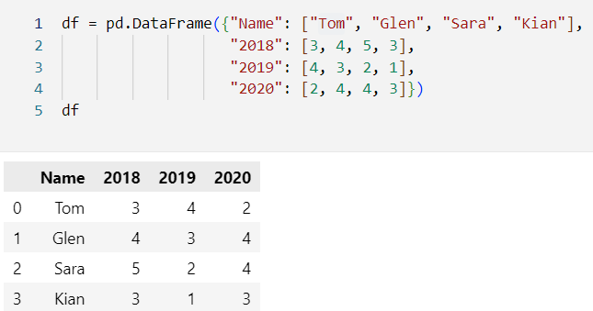
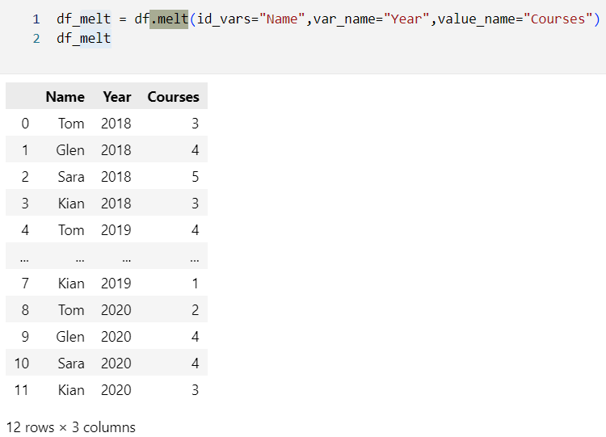
Melt example
Notes:
The DataFrame shows the number of courses taken by a student in a specific year → pivot table
After melt() you have the unpivoted data → this is a good example the result is tidy

Slide 20
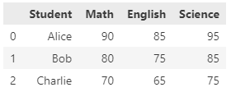
Melt, other example
Suppose you were given the following DataFrame
Can you (easily) calculate the average score for every student?
No, because they are in different columns
df["avg"] = (df["Math"] + df["English"] + df["Science"]) / 3
→ Not maintainable code!
Notes:
df["avg"] = (df["Math"] + df["English"] + df["Science"]) / 3 is not maintainable code
df_melted = pd.melt(df, id_vars=['Student'], value_vars=['Math', 'English', 'Science'], var_name='Subject', value_name='Score’)
df_mean = df_melted.groupby('Student')['Score'].mean().reset_index()

Slide 21
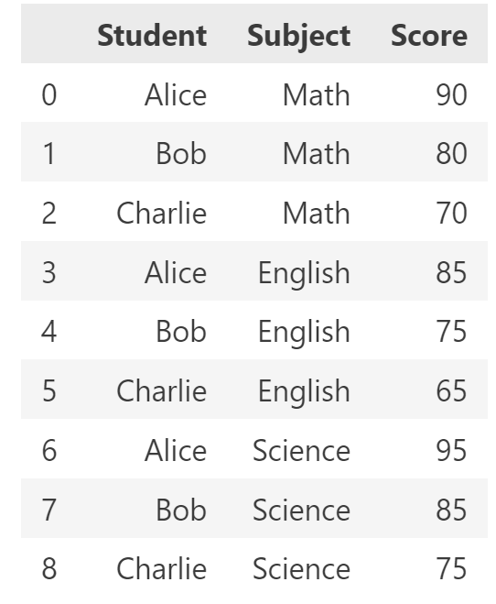
Melt, other example
Solution: melt!
The average per student can now be calculated using group by
Notes:
df["avg"] = (df["Math"] + df["English"] + df["Science"]) / 3 is not maintainable code
df_melted = pd.melt(df, id_vars=['Student'], value_vars=['Math', 'English', 'Science'], var_name='Subject', value_name='Score’)
df_mean = df_melted.groupby('Student')['Score'].mean().reset_index()

Slide 22
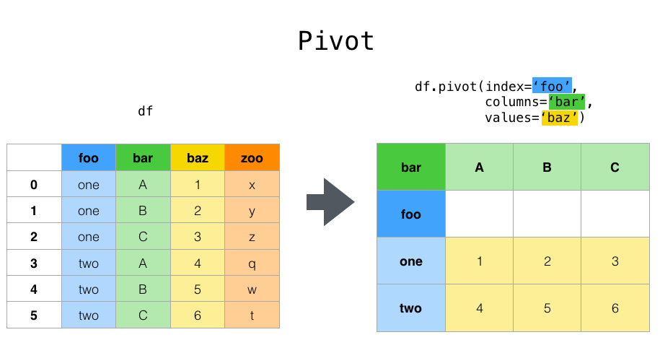
Pivot
Pivot is basically the opposite of melt
It combines multiple rows and uses one of the values as column name and the other as value
Watch out, other columns may be dropped in the process
Like “zoo” in the example

Slide 23
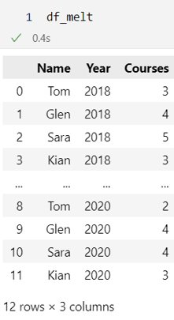
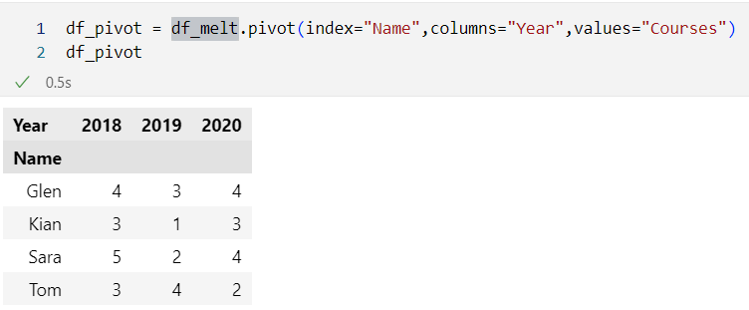
Pivot example
The simple example would be to un-melt the DataFrame we made before

Slide 24
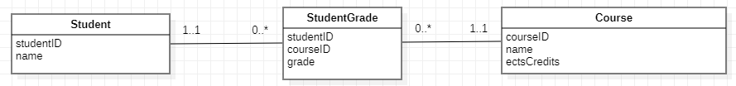
Pivot usage
A lot of numerical data is stored in SQL-databases
SQL-databases are normalized, so that would look like this:
It’s impossible to write a SQL-query where the rows of the table “Course” become the column names
But when you want to use the grades of students to do machine learning, you need all the grades on one line
Pivot!

Slide 25
Pivot and summarize
Up until now we only used pivot to copy values
The example: every combination of “Name” and “Year” was unique
But pivot can also create summaries
What is the average number of courses per student?
What is the total number of courses per student?
What is the standard deviation of the number of courses students took per year?
That is when we start using a pivot table
You have this in Excel as well

Slide 26
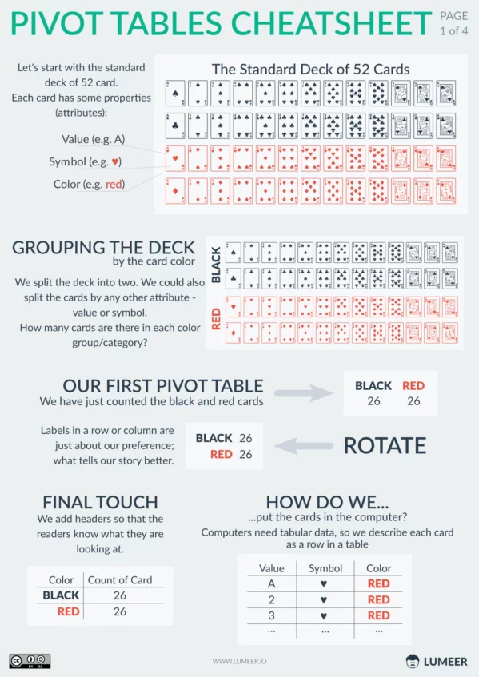
Pivot table
A Pivot table:
is used to summarize, sort, reorganize, group, count, total or average data stored in a table.
allows us to transform columns into rows and rows into columns.
allows grouping by any field (column) and performing advanced calculations on them.
https://www.lumeer.io/pivot-tables-cheatsheet/

Slide 27
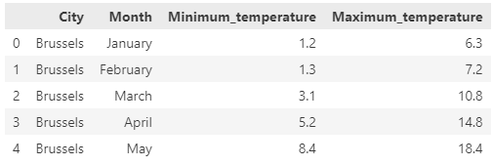
Pivot table: pivot()
What we start with: Minimum and maximum temperatures for some cities
The cities we have:
['Brussels', 'Amsterdam', 'London’, 'Berlin', 'Madrid', 'Sydney’]
https://pandas.pydata.org/docs/reference/api/pandas.pivot_table.html

Slide 28
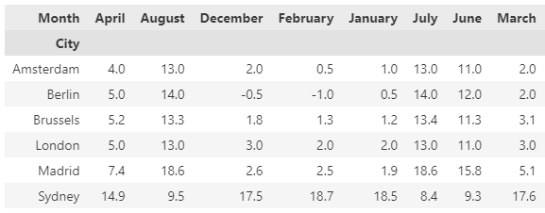
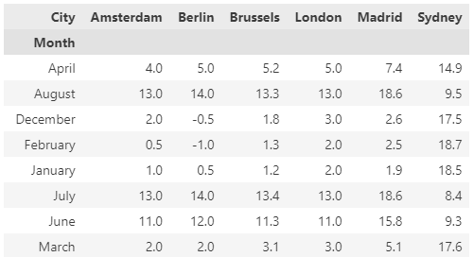
Pivot table: pivot()
“Unfold” the table by using pivot()
Cities vs months or the other way around
df_pivot = df.pivot(index="City",columns="Month",values="Minimum_temperature")
df_pivot = df.pivot(index="Month",columns="City",values="Minimum_temperature")
The order of the months is wrong!
We lose the maximum temperature!
Notes:
df_pivot = df.pivot(index="City",columns="Month",values="Minimum_temperature")
df_pivot = df.pivot(index="Month",columns="City",values="Minimum_temperature")
But a lot is wrong that they know about:
How to get the months in order? Define them as an ordered categorical!
We lose the max temperature

Slide 29
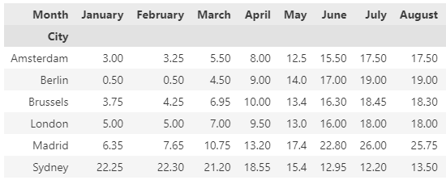
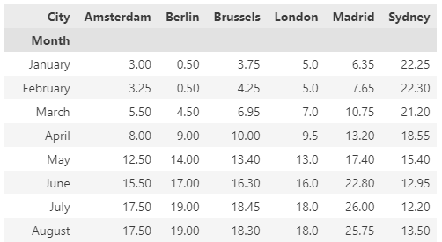
Pivot table - revisited
“Unfold” the table using pivot()
Cities vs months or the other way around
Months appear chronologically
Average temperature in cells instead of min or max temperatures
What did we do to arrange the months chronologically?
Notes:
df_pivot = df.pivot(index="City",columns="Month",values="Minimum_temperature")
df_pivot = df.pivot(index="Month",columns="City",values="Minimum_temperature")
But a lot is wrong that they know about:
How to get the months in order? Define them as an ordered categorical!
We lose the max temperature

Slide 30
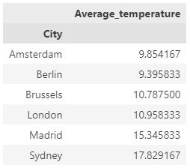
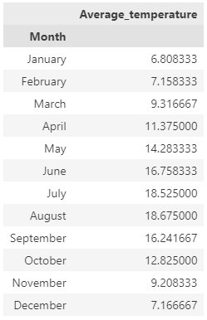
Pivot table with aggregations: pivot_table()
What is the average (mean) temperature per city or per month?
table = pd.pivot_table(df, values='Average_temperature', index=['City'], aggfunc="mean")
table = pd.pivot_table(df, values='Average_temperature', index=['Month'], aggfunc="mean")
Notes:
table = pd.pivot_table(df, values='Average_temperature', index=['City'], aggfunc="mean")
table = pd.pivot_table(df, values='Average_temperature', index=['Month'], aggfunc="mean")
table

Slide 31
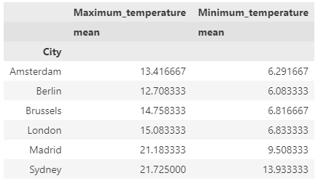
Pivot table with aggregations: pivot_table()
What are the average minimum and maximum temperatures per city?
table = pd.pivot_table(df, values=['Minimum_temperature','Maximum_temperature’], index=['City'], aggfunc={'Minimum_temperature’:["mean"], 'Maximum_temperature':["mean"]})
Notes:
table = pd.pivot_table(df, values=['Minimum_temperature','Maximum_temperature'], index=['City'], aggfunc={'Minimum_temperature': ["mean"],'Maximum_temperature':["mean"]})

Slide 32
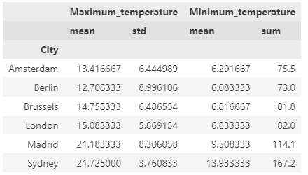
Pivot table with aggregations: pivot_table()
Could we add the sum for the minimum temperatures and the standard deviation for the maximum temperatures?
table = pd.pivot_table(df, values=['Minimum_temperature','Maximum_temperature’], index=['City'], aggfunc={'Minimum_temperature': ["mean","sum"], 'Maximum_temperature':["mean","std"]})
Notes:
table = pd.pivot_table(df, values=['Minimum_temperature','Maximum_temperature'], index=['City'], aggfunc={'Minimum_temperature': ["mean", "sum"],'Maximum_temperature':["mean","std"]})

Slide 33
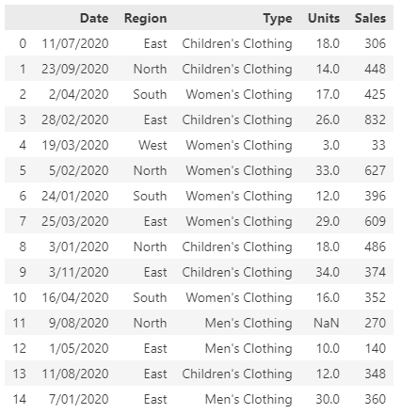
Crosstabulation
Look at the data on the right
We see some numbers (units and sales), but a lot of categorical data (date, region and type)
What possible questions on grouped data might there be:
More children’s clothing sold in the East?
More women’s clothing sold in April?
Low sales in the South in winter months?
Cross tabulation will help us investigate this
Notes:
Difference between crosstab() and pivot_table()
The pivot_table() functions accepts a Pandas DataFrame as an input whereas the crosstab() function accepts both Pandas DataFrames, and NumPy arrays.
The crosstab() function can be used to view normalized data. The pivot_table() function does not contain any default functionality for data normalization.
By default, the pivot_table() function displays mean values. The crosstab() displays the count of occurrence (=frequency) for each combination in the cross tabulation.

Slide 34
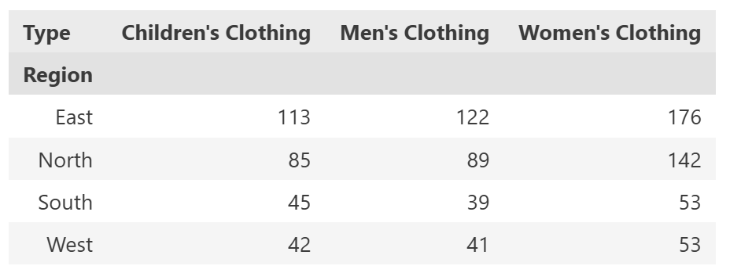
Crosstab: region vs type
pd.crosstab(df.Region, df.Type)
By default, in each cell the number of records in the DataFrame per region and type are shown
So, in each region the most sales registrations are for women’s clothing.

Slide 35
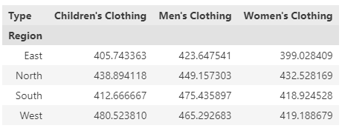
Crosstab: region vs type
pd.crosstab(index = df_pivot.Region, columns = df_pivot.Type, values = df_pivot.Sales, aggfunc = 'mean')
This is the same crosstab as on the previous slide, but now we’re displaying the mean of sales revenue
So now we know that:
In women’s clothing we have the lowest sales revenue. When women buy something, they buy less items or less expensive items. (From before we knew they made more sales though, so they might just like to go shopping.)
Sales revenues are smaller in the East
Notes:
pd.crosstab(index = df_pivot.Region, columns = df_pivot.Type, values = df_pivot.Sales, aggfunc = 'mean')

Slide 36

An overview in graphs
As people we like our numbers in graphs
Unless you’re him:
When doing data science, which implies you have no or limited domain knowledge, you explore the data by making graphs
These graphs raise questions, that spark more graphs
Repeat until you understand the data
Notes:
Christian Bale in The Big Short

Slide 37
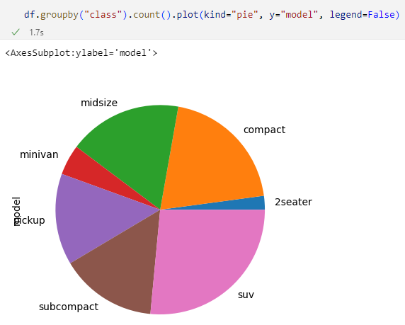
The pie chart
Pie charts are great. They not only have many colors, but they also remind us it’s time for a break. We need more pie!
But seriously, don’t use pie charts unless you respect the rules:
Max 6 slices
In descending order
Percentages printed
Notes:
But seriously, don’t use pie charts.
https://www.data-to-viz.com/caveat/pie.html
Unless you follow the rules (always display the percentage, order the values from big to small starting at 12:00 and never plot more than 6 slices) → So this pie is completely wrong

Slide 38
Scatter plot
Scatter plot:
Data visualisation technique to show the relationship between two numerical variables.
DataFrame.plot.scatter(x, y, s = none, c = none)
x: column name to be used as horizontal coordinates for each point
y: column name to be used as vertical coordinates for each point
s: size of dots
c: color of dots
BTW, we’re using the cars dataset ‘MPG’ here
The MPG dataset contains 234 cars and their mileage (~ chapter 5)
https://ggplot2.tidyverse.org/reference/mpg.html

Slide 39
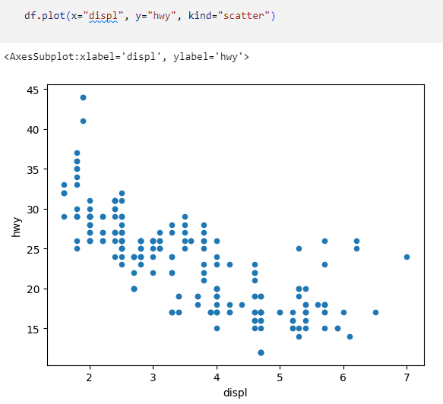
Scatter plot
The easiest plot possible: plot highway miles per gallon vs engine displacement
How far you can drive vs how big your engine is

Slide 40
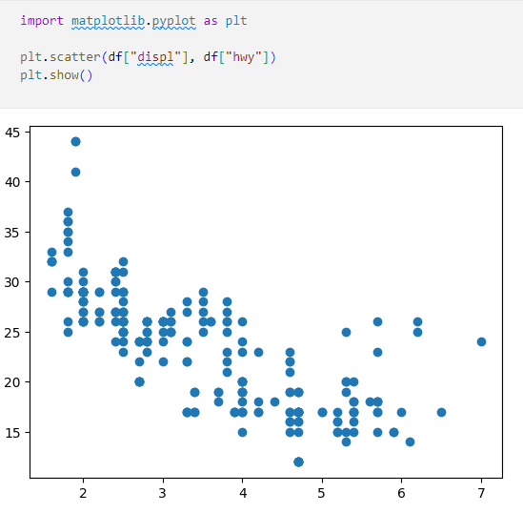
Pandas vs matplotlib
Pandas uses matplotlib under the hood, but you can use it separately
You get the same graph, but the labels on the axes are gone

Slide 41
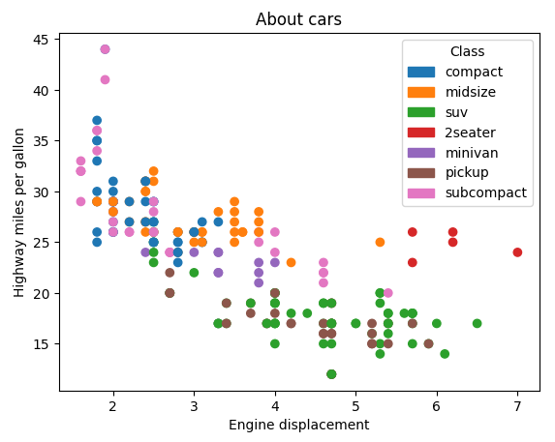
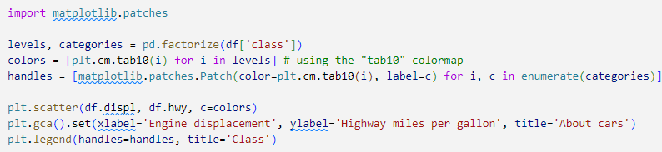
Scatter with factors
Maybe the class of the car has an impact on this graph. Could we color the dots according to the class?
Code also in notebook.
Notes:
Explanation: pd.factorize(df['class'])
Factorize() creates an array of unique values and a corresponding index for categoricals.
Example:
labels, uniques = pd.factorize(['b', 'd', 'd', 'c', 'a', 'c', 'a', 'b'])
print("Numeric Representation : \n", labels)
print("Unique Values : \n", uniques)
Result:
Numeric Representation : [0 1 1 2 3 2 3 0]
Unique Values : ['b' 'd' 'c' 'a’]
Explanation: plt.gca()
Gca() stands for Get Current Axes (=plotting zone)

Slide 42
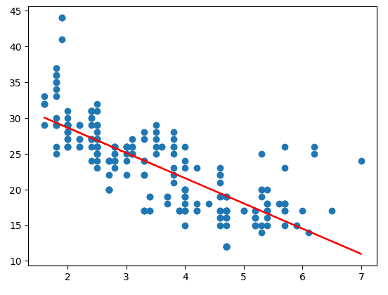
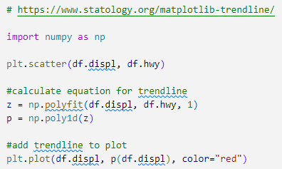
A trendline: ax+b
We’ve seen the trend in the data (bigger engines are less economical), but can we show it?
Notes:
Polyfit returns a list with the coefficients of the equation y = ax +b
[a,b]
Poly1d creates the equation based on these returned coefficients:
→ ax + b

Slide 43
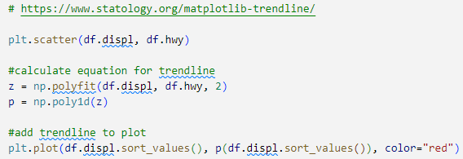
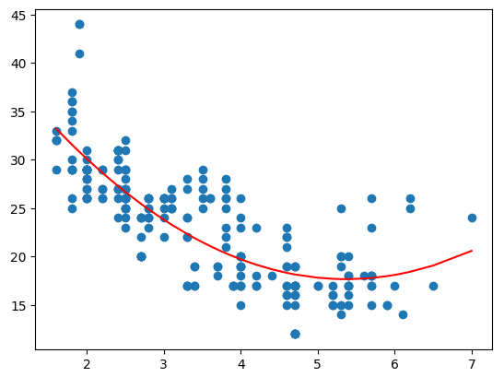
A trendline: ax²+bx+c
Maybe the relationship is of the second order?
Notes:
y = ax² +bx +c
Polyfit returns a list with the coefficients of the equation y = ax² +bx +c
[a,b,c]
Poly1d creates the equation based on these returned coefficients:
→ ax² +bx +c
coefficient a positief: dal parabool
coefficient a negatief: top parabool

Slide 44
Trendline
The trendline shows there is a relationship between engine displacement and highway miles per gallons
In statistical terms, this is called a covariance
It’s a number you can calculate by using some cool formula
But it doesn’t mean anything, as it will greatly depend on the actual numbers
Big number: between number of ants and number of blades of grass
Small number: between number of kids and number of cars
The strength of a covariance is expressed as the correlation
Can also be calculated using another cool formula
Is always between -1 and +1 -> can be compared

Slide 45
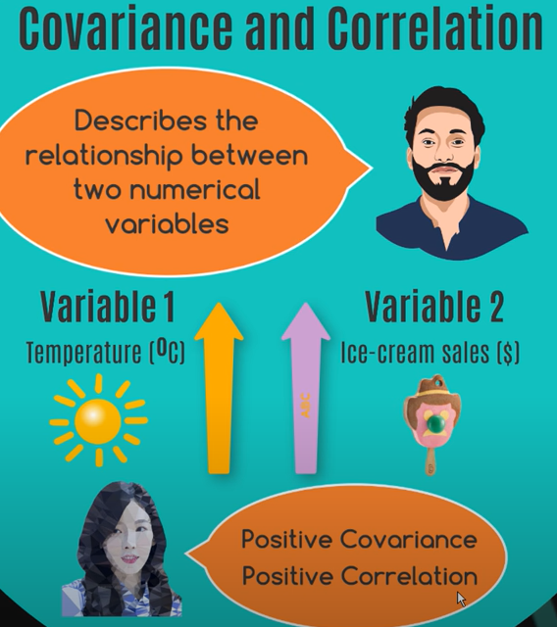
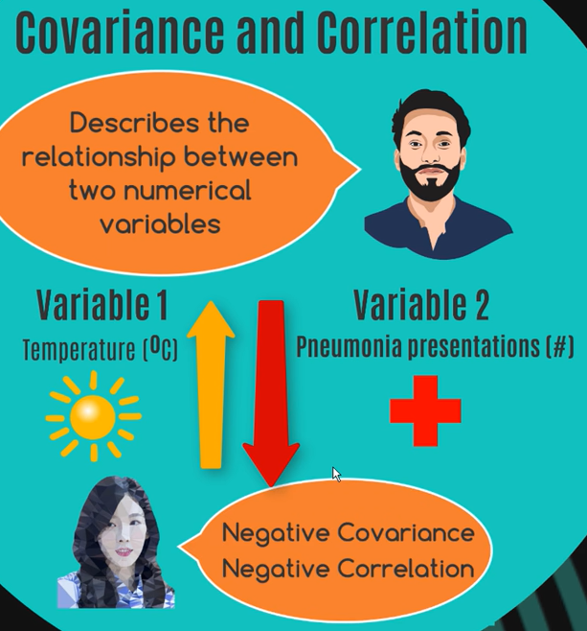
https://www.youtube.com/watch?v=mG__Wpp9dns&ab_channel=zedstatistics
Notes:
https://www.youtube.com/watch?v=mG__Wpp9dns&ab_channel=zedstatistics

Slide 46
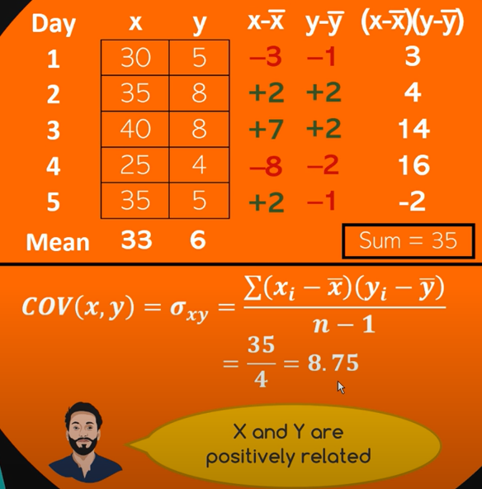

The cool formulas
Notes:
https://www.mathsisfun.com/data/standard-deviation.html (dogs example)
https://www.mathsisfun.com/data/correlation.html
The variance = the average of the squared differences from the Mean.
The standard deviation (Greek letter sigma) is the square root of the Variance (Greek letter sigma²).
var(x)= (standard deviation)²
var (x) = (-3)² +2² +7² +(-8)² + 2²) /4 = 32,5
stdev (x) = square root van var(x) or 32,5= 5,7

Slide 47

Correlation = measure of strength
Notes:
Greek symbol for correlation is rho

Slide 48



Extremes of correlation
Correlation = 1 Perfect positive relationship
Correlation = 0
No pattern
Correlation = -1
Perfect negative relationship

Slide 49

Covariance does not imply causation
Notes:
Most startup billionaires are high-school dropouts.
“I’ll quit school, so I’ll become a billionaire” Watch out with strong conclusions!!

Slide 50
Correlation in DataFrames
A scatter plot is a very useful plot to check if there is correlation between two variables in a dataset
But which variables correlate well, and which don’t? You have 2 options:
Check numerically: calculate correlation matrix
Check visually: plot a scatter matrix

Slide 51

Correlation matrix
Calculate the correlation between all columns
Or all numerical columns, to be precise
Gives you a number showing how much they are related
0: No correlation
1: One goes up, other goes up
-1: One goes up, other goes down
The closer the number is to +1/-1, the better the correlation

Slide 52

Scatter matrix
The same as a correlation matrix, but instead of numbers you get a scatter plot
Some plots stand out:
cty vs hwy: near perfect correlation
year vs …: Only 2 distinct values for year are present
cyl: few distinct values, but some correlation with displ

Slide 53
Scatter matrix
Did we see that correctly?
cty vs hwy: near perfect correlation
cty: Miles per gallon in the city
hwy: Miles per gallon on the highway
cyl: few distinct values, but some correlation with displ
cyl: the number of cilinders
displ: the size of the engine (in liters)
So yes, what we saw in the graphs is also true in real life

Slide 54
Boxplots, skewing and distributions
When investigating it’s important to recognize certain patterns in the distribution of data
Fortunately, there’s a whole field of knowledge concerning itself with just that:
And we’d like very much to prep you for a couple of weeks in just the theoretical background of analysis of distributions, correlations, covariations, …
But that would be a step too far...
But what you do need to understand is the normal distribution
Statistics!

Slide 55

Normal distribution
Most data will have a “normal” distribution
This means:
A lot of datapoints in the center (red part)
Some datapoints to the side (blue part)
Leftovers left and right (green and ... part)
Standard deviation is a measure for the steepness of the curve
Notes:
https://towardsdatascience.com/understanding-the-68-95-99-7-rule-for-a-normal-distribution-b7b7cbf760c2

Slide 56
Normal distribution in boxplot
A normal distribution is a plot of 1 variable, with varying standard deviation
The smaller your stddev, the steeper the curve, the easier to predict
The bigger your stddev, the flatter and widen the curve, the more spread your data, the more difficult to predict
In case you want to compare 2 variables like prices of fiction vs prices of non-fiction books, you need a more compact way of showing a distribution
Enter: The Boxplot
Notes:
https://www.r-graph-gallery.com/boxplot.html

Slide 57

The yellow line: the median
The box: the red part
The lines: the blue part
The dots: the green part
IQR: Interquartile Range The difference between Q1 and Q3 which measures the spread of the middle 50% of the data.
Notes:
https://towardsdatascience.com/understanding-boxplots-5e2df7bcbd51

Slide 58

Dataset skewing
All data is ‘normal’, but some is more normal than others
or Right Skewed
or Left Skewed
Notes:
https://en.wikipedia.org/wiki/Skewness
https://www.statology.org/left-skewed-vs-right-skewed/
Negative skew = left skewed = tail on the left side
Positive skew = right skewed = tail on the right side

Slide 59


skew()
Skewness is a measure of the asymmetry of a distribution. A distribution is asymmetrical when its left and right side are not mirror images.
Describes the distribution of a variable alongside other descriptive statistics
Determines if a variable is normally distributed. A normal distribution has zero skew and is an assumption of many statistical procedures.
https://www.scribbr.com/statistics/skewness/

Slide 60

Example: age of mother when giving birth
Some mothers are only 15, but these are exceptions
Most women give birth in their 20’s
School is finished, found life-long partner, …
There are still quite a few women giving birth in their 30’s
Enjoyed life first, settled later
Some exceptions are in their 40’s
You’ll be 60 by the time the kid graduates, which is not ideal
Conception becomes difficult after that age
Notes:
Before 15 and after 50 it’s (generally) impossible to conceive.

Slide 61

More baby-examples
Notes:
- Weight: skewed, babies have to be big enough to be born
- Age: see before
- Height: pretty normal
- Gestation (length of pregnancy in days): normal. 40 weeks = 280 days, which is the spike

Slide 62
Negative skew or left skewed
Distribution of Age of Deaths
The distribution of the age of deaths in most populations is negatively skewed. Most people live to be between 70 and 80 years old, with fewer and fewer living less than this age.
Distribution of Olympic Long Jumps
In most years, the distribution of long jump lengths for competitors in the Olympics is negatively skewed because most competitors land a jump around 7.5-8 meters, with a few landing a jump of just 5-6 meters.
Distribution of Scores on Easy Exams
The distribution of scores on easy exams or tests tend to be negatively skewed because most students score very high, while a few students score much lower than the average.
Notes:
https://www.statology.org/negatively-skewed-distribution-examples/
Negative skew = Left skewed = tail on the left

Slide 63
Positive skew or right skewed
Distribution of Income
The distribution of individual incomes in the U.S. is right-skewed, with most individuals earning between $20k and $40k per year but with a long right tail of households that earn much more.
Distribution of Pet Ownership
The distribution of the number of pets that households own in any particular city is likely to be right skewed because most households have either 0 or 1 pet, but there are many outlier households that have 7, 8, 9+ pets that cause the distribution to be right skewed.
Distribution of Scores on Difficult Exams
The distribution of scores on any particularly difficult exam will be positively skewed with most students scoring around some mean value with a few outlier students scoring much higher.
Notes:
https://www.statology.org/positively-skewed-distribution-examples/
Positive skew = right skewed = tail on the right

Slide 64

Boxplot skewing
How does a boxplot show skewing?
The middle line is always the center of your data (median)
If that is a perfect mirror-line, your data is perfectly symmetrical and perfectly normal
But if the box is smaller on one side of the line, the data is “steeper” there
Less different values, but they occur more
Usually, a small box on one side also means a shorter line
Notes:
Negative skew = Left skewed = tail on the left
Positive skew = right skewed = tail on the right

Slide 65

Basic boxplot
Compare the distribution of 4 categories
1 variable
In 4 categories
You see how
A is very spread out (unsteep bell curve)
D is very compact (pointy bell curve)
All are pretty ‘normal’ or symmetrical distributed

Slide 66

Advanced boxplot
You see all the above and:
C doesn’t have a lot of datapoints
B has two peaks

Slide 67

Violin plot
Comparable to a boxplot, but the numbers are no longer there
Prettier, but not always better
Because it doesn’t compare: are there more A’s than D’s? Or C’s? How much steeper is A’s curve compared to C?
You can use a violin-plot to raise questions, but rarely to answer them
Example: is there a property in the B-dataset that splits the two bumps?

Slide 68




Once again: Mean (average), standard deviation
Notes:
Population mean = greek letter mu

Slide 69

Mean (average), standard deviation
https://www.youtube.com/watch?v=wpY9o_OyxoQ&ab_channel=zedstatistics
Notes:
https://www.mathsisfun.com/data/standard-deviation.html (dogs example)
Golden Gaytime is a popular ice cream snack that is made and distributed by the a confectionery company in Australia, and first released in 1959.It is a toffee and vanilla ice cream dipped in chocolate, and wrapped in vanilla biscuit-like "crumbs" on a wooden stick. Its name has survived intact regardless, or because, of the possible homosexual connotations in modern decades.

Slide 70

Mean (average), standard deviation
https://www.youtube.com/watch?v=wpY9o_OyxoQ&ab_channel=zedstatistics
Notes:
https://www.youtube.com/watch?v=wpY9o_OyxoQ&ab_channel=zedstatistics

Slide 71


Mean (average), standard deviation
Why square stuff for calculating variance and standard deviation?
Add up all of the squared deviations: → 421.5
Variance (s²) Divide the sum of the squared deviations by N – 1: →421.5/ (6-1) = 84.3
Standard deviation (s) Calculate the square root of variance →$\sqrt{84,3}=9.18$
From learning that s = 9.18, you can say that on average, each score deviates from the mean by 9.18 points.
Notes:
FYI: why do we devide by N-1 instead of N to calculate variance? The variance should predict variance from population mean but we work with sample means. So when dividing by 6 we would have a smaller variance. So to compensate for this estimate mean we divide by sample size -1.

Slide 72

Back to the babies
On the right are 2 graphs: the weight of a baby at birth and the duration of the pregnancy (gestation)
To be comparable they were normalised
Recalculated to be between 0 and 1 in stead of 150 and 350 or 52 and 72
[For more information on normalisation see chapter 4]
The top graph is wider, the bottom one slimmer
Top standard deviation: 0.13
Bottom standard deviation: 0.08

Slide 73

Distributions in mpg
Before we go into deep analysis, let’s start practically:
Create a simple plot of the distribution for highway miles per gallons in the MPG-dataset
It’s a continuous variable, so we can’t count it
Solution: binning
Take some of the values together
Which? Size of the bin
In this case: let pandas decide on the bin size
Notes:
Counting a continuous variable:
10.2343: 1x
10.2344: 1x
10.2345: 2x
10.2346: 0x
…

Slide 74


Binning
Maybe more bins? Or less bins?
Depends on the data…
Notes:
→ In dataviz students must use Sturge’s rule to define the numbers of bins https://www.statisticshowto.com/choose-bin-sizes-statistics/ Sturge’s rule works best for continuous data that is normally distributed and symmetrical. It helps us to convert this data into discrete, symmetric, binomial classes. As long as your data is not skewed, using Sturge’s rule should give you a nice-looking, easy to read histogram that represents the data well.

Slide 75


Truly normal data
Mpg doesn’t have truly normal data (doesn’t have enough records)
But we can generate it!

Slide 76


Comparing histograms
The entire hwy-column isn’t normal, but maybe when we divide it by class of car?
Can we show all histograms in one graph?
Sure!
But it looks really bad…

Slide 77


All hail the boxplot
Boxplots will fix that mess quickly
Remember: boxplots simplify data. Sometimes that is bad, but mostly it helps making data understandable and comparable.
The graph shown here is clear and tells a story. That is what we need.

Slide 78

Violins are nice too
They look better but contain way more information making them harder to understand.
Violins are good to raise questions (why is purple such an ugly blob?) but never to answer them.

Slide 79

Exercises

